Slide 1


Slide 2
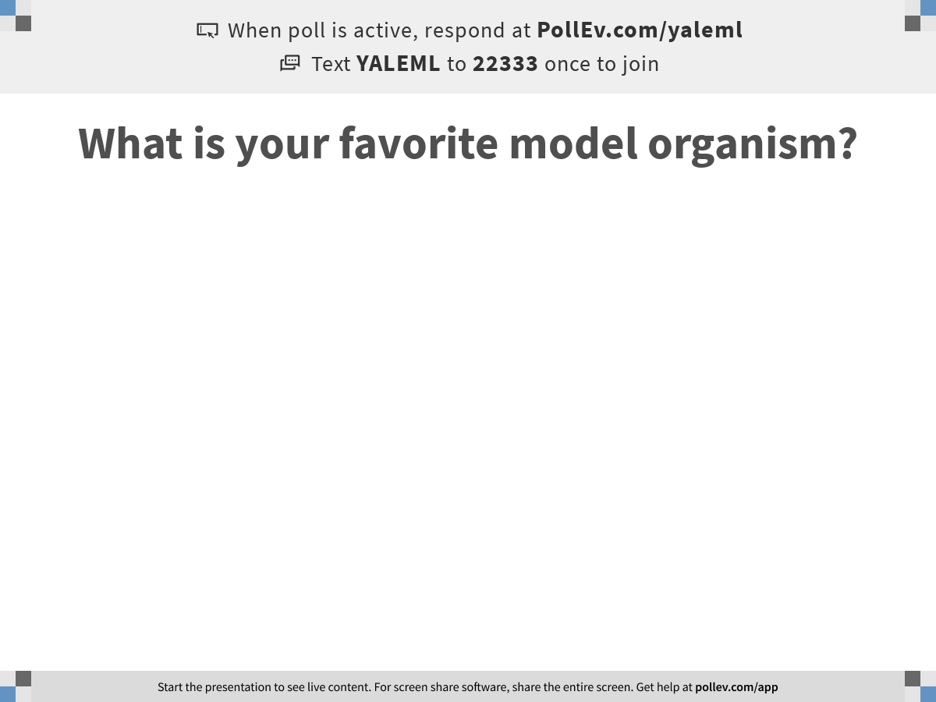
Notes:
What is your favorite model organism?
https://www.polleverywhere.com/free_text_polls/bi9MJ5vC17sTijM4RmagV

Slide 3

Machine Learning for Single Cell Analysis
Course introduction
Notes:
TA introduction
Talk about not teaching code (not a programming workshop)

Slide 4

https://krishnaswamylab.org/get-help

Slide 5


Slide 6
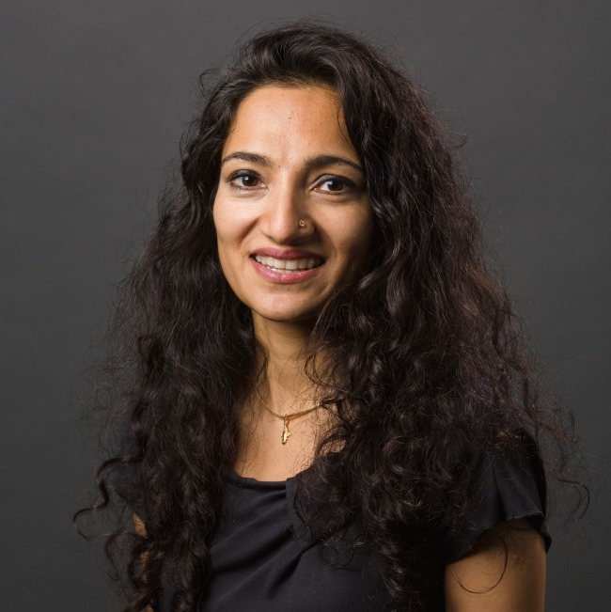
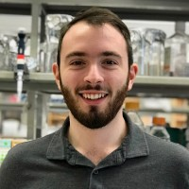


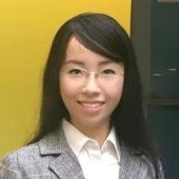
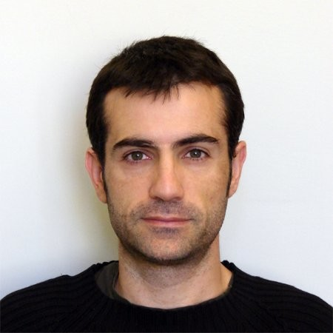




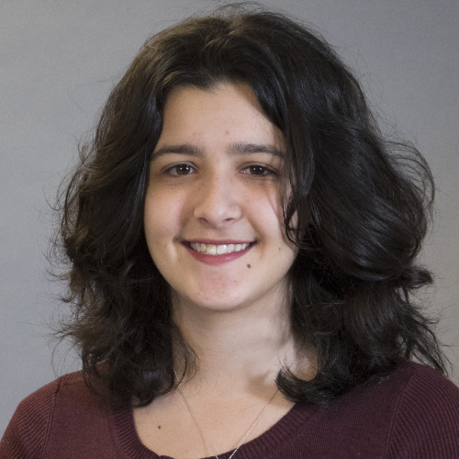
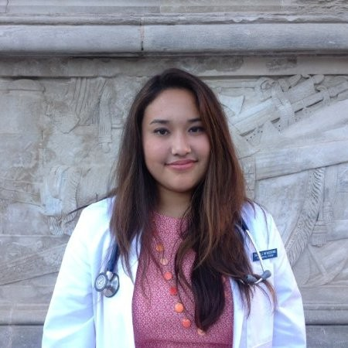
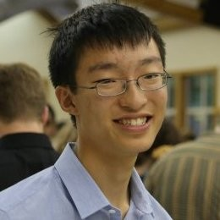

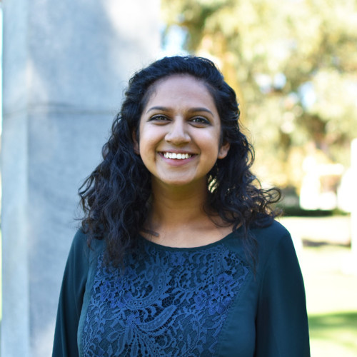
Smita Krishnaswamy, PhD
Daniel Burkhardt
Scott Gigante
Nur-Taz Rahman, PhD
Mamie Wang
Francesc Lopez, PhD
Andrew Benz
Egbert Castro
Wes Lewis
Matthew Amodio
Edel Aron
Danielle Miyagishima
Alexander Tong
Evan Cudone
Aarthi Venkat
…and Sameet Mehta, PhD!

Slide 7
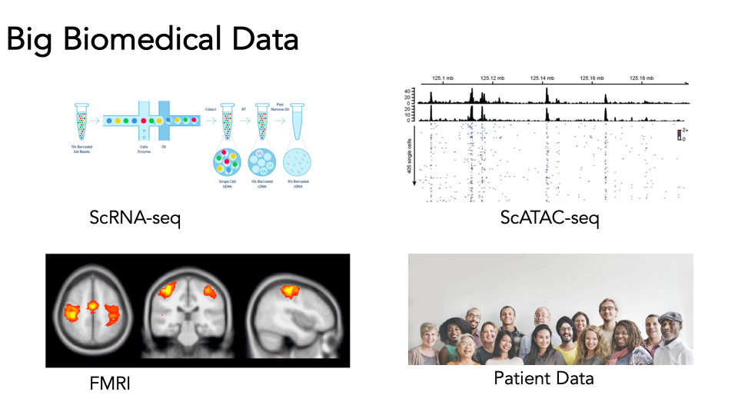
Big biomedical data
Big = Any dataset with many many observations

Slide 8
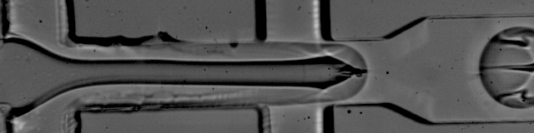
The single cell revolution
Beads
Lysis buffer
Data
Cells
Oil
http://mccarrolllab.org/dropseq/

Slide 9
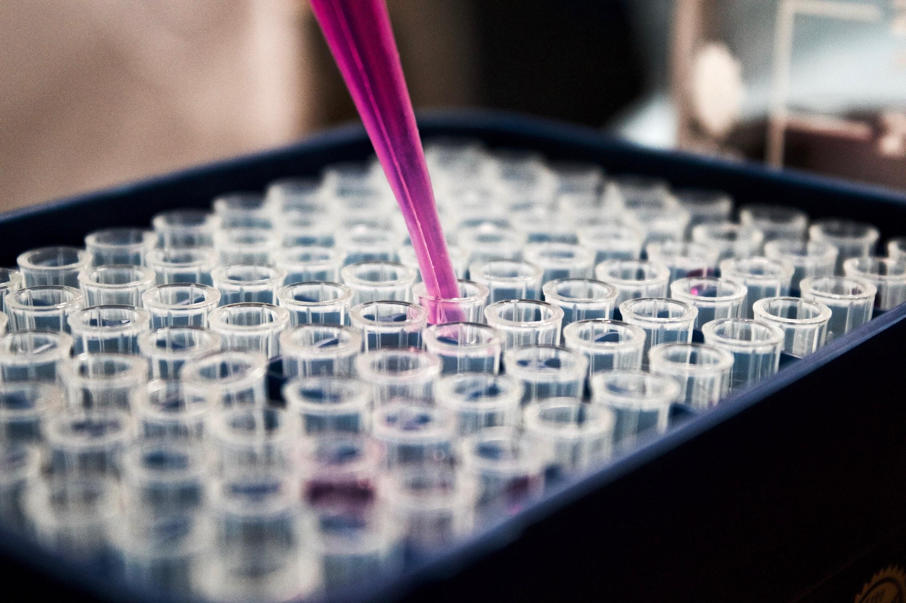

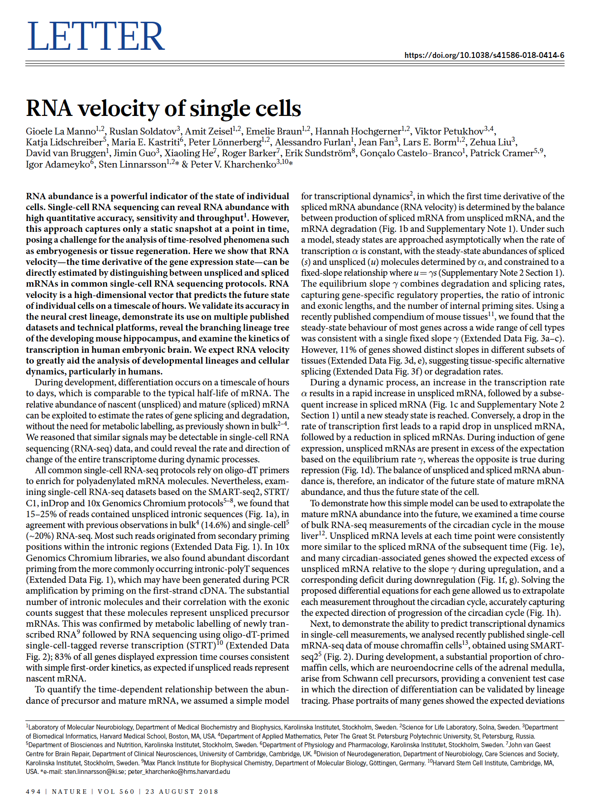
The single cell revolution
Interesting Biological Experiments
Computation
High impact paper

Slide 10
The single cell revolution
Interesting Biological Experiments
Computation
High impact paper
Machine learning
Linear algebra
Probability theory
Statistical analysis
Algorithm design

Slide 11
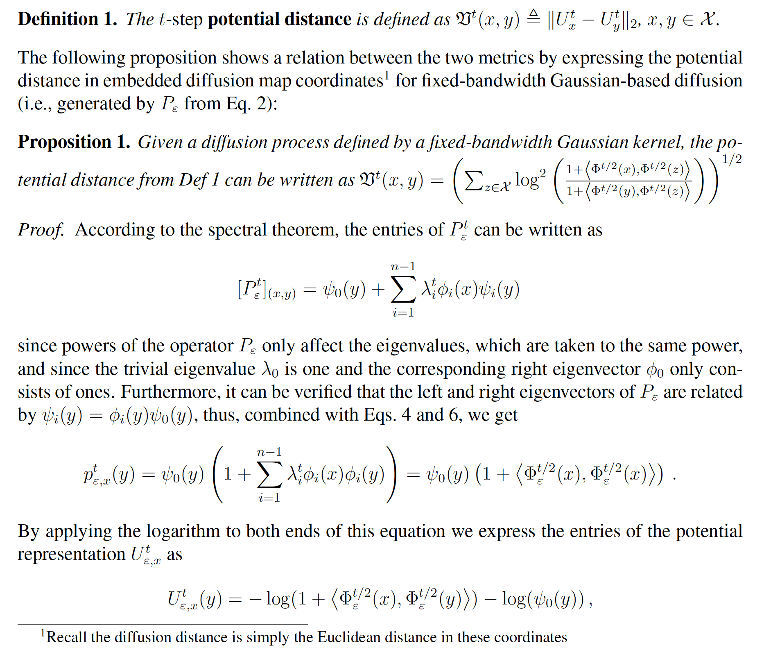
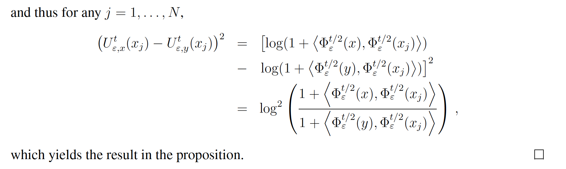
It’s all Greek to me...
Moon et al. (2019)

Slide 12

What reading single cell methods can feel like

Slide 13
What is machine learning?

Slide 14
What is machine learning?
Machine learning is the process of identifying patterns in data.

Slide 15

Two kinds of machine learning
Supervised learning
Have a bunch of labelled data, want to label new data

Slide 16


Two kinds of machine learning
Supervised learning
Have a bunch of labelled data, want to label new data
Supervised Learning Model
Noun project

Slide 17
Two kinds of machine learning
Supervised learning
Have a bunch of labelled data, want to label new data
Supervised Learning Model
Strawberry!
Noun project

Slide 18
Two kinds of machine learning
Supervised learning
Have a bunch of labelled data, want to label new data
Supervised Learning Model
Noun project

Slide 19
Two kinds of machine learning
Supervised learning
Have a bunch of labelled data, want to label new data
Supervised Learning Model
Banana
Noun project

Slide 20
Two kinds of machine learning
Supervised learning
Have a bunch of labelled data, want to label new data
Supervised Learning Model
Noun project

Slide 21
Two kinds of machine learning
Supervised learning
Have a bunch of labelled data, want to label new data
Supervised Learning Model
Strawberry!
Noun project

Slide 22
Two kinds of machine learning
Supervised learning
Have a bunch of labelled data, want to label new data
Supervised Learning Model
Noun project

Slide 23
Two kinds of machine learning
Supervised learning
Have a bunch of labelled data, want to label new data
Supervised Learning Model
?
Noun project

Slide 24
Two kinds of machine learning
Supervised learning
Have a bunch of labelled data, want to label new data
Supervised Learning Model
Strawberry!
Noun project

Slide 25



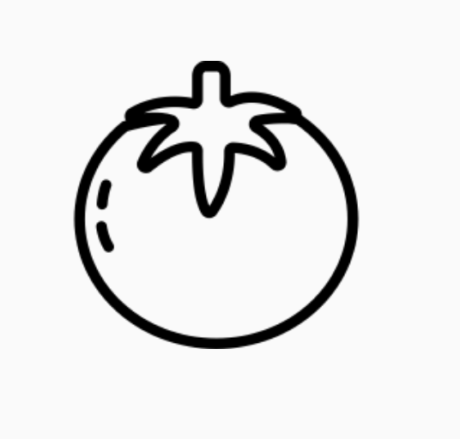

Two kinds of machine learning
Supervised learning
Have a bunch of labelled data, want to label new data
Unsupervised learning
Have a bunch of unlabeled data, want to organize it
Supervised Learning Model
Unsupervised Learning Model
Strawberry
Noun project
Notes:
Differentiate between supervised and unsupervised learning, left figure should have the label strawberry as output, right figure should also just have one image but it should have maybe a couple of vectors (of numbers) as output

Slide 26
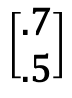
Two kinds of machine learning
Supervised learning
Have a bunch of labelled data, want to label new data
Unsupervised learning
Have a bunch of unlabeled data, want to organize it
Supervised Learning Model
Unsupervised Learning Model
Strawberry
$$\left[\begin{matrix}.7 \\ .5\end{matrix}\right]$$
Noun project
Notes:
Differentiate between supervised and unsupervised learning, left figure should have the label strawberry as output, right figure should also just have one image but it should have maybe a couple of vectors (of numbers) as output

Slide 27
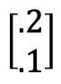
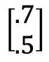
Two kinds of machine learning
Supervised learning
Have a bunch of labelled data, want to label new data
Unsupervised learning
Have a bunch of unlabeled data, want to organize it
Supervised Learning Model
Unsupervised Learning Model
Strawberry
$$\left[\begin{aligned}.2 \\ .1\end{aligned}\right]$$
$$\left[\begin{aligned}.7 \\ .5\end{aligned}\right]$$
Noun project
Notes:
Differentiate between supervised and unsupervised learning, left figure should have the label strawberry as output, right figure should also just have one image but it should have maybe a couple of vectors (of numbers) as output

Slide 28
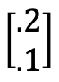
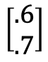
Two kinds of machine learning
Supervised learning
Have a bunch of labelled data, want to label new data
Unsupervised learning
Have a bunch of unlabeled data, want to organize it
Supervised Learning Model
Unsupervised Learning Model
$$\left[\begin{aligned}.2 \\ .1\end{aligned}\right]$$
Strawberry
$$\left[\begin{aligned}.6 \\ .7\end{aligned}\right]$$
$$\left[\begin{aligned}.7 \\ .5\end{aligned}\right]$$
Noun project
Notes:
Differentiate between supervised and unsupervised learning, left figure should have the label strawberry as output, right figure should also just have one image but it should have maybe a couple of vectors (of numbers) as output

Slide 29
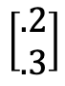
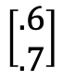
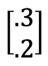
Two kinds of machine learning
Supervised learning
Have a bunch of labelled data, want to label new data
Unsupervised learning
Have a bunch of unlabeled data, want to organize it
Supervised Learning Model
Unsupervised Learning Model
$$\left[\begin{aligned}.3 \\ .2\end{aligned}\right]$$
$$\left[\begin{aligned}.2 \\ .1\end{aligned}\right]$$
$$\left[\begin{aligned}.2 \\ .3\end{aligned}\right]$$
Strawberry
$$\left[\begin{aligned}.7 \\ .5\end{aligned}\right]$$
$$\left[\begin{aligned}.6 \\ .7\end{aligned}\right]$$
Noun project
Notes:
Differentiate between supervised and unsupervised learning, left figure should have the label strawberry as output, right figure should also just have one image but it should have maybe a couple of vectors (of numbers) as output

Slide 30
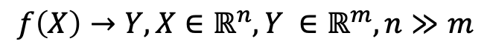
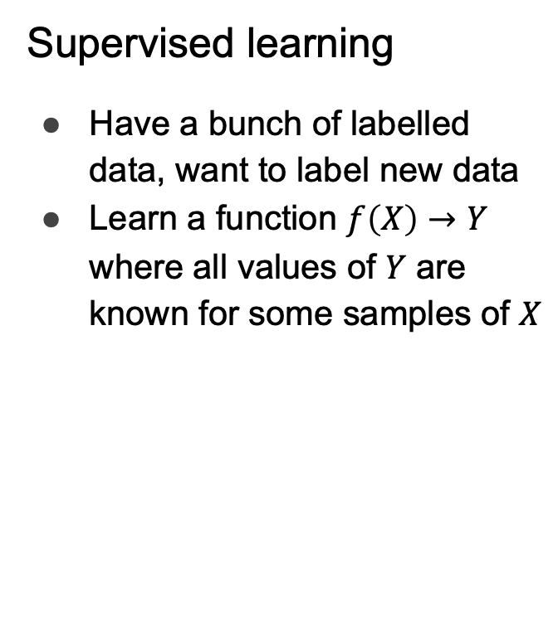
Two kinds of machine learning
Supervised learning
Have a bunch of labelled data, want to label new data
Learn a function $f\left(X\right)→Y$ where all values of $Y$ are known for some samples of $X$
Unsupervised learning
Have a bunch of unlabeled data, want to organize it
Learn an embedding
Lower dimensional, easier to interpret (e.g. as clusters)
$$f\left(X\right)→Y, X∈ℝ^{n},Y ∈ℝ^{m}, n≫m$$
Supervised Learning Model
Unsupervised Learning Model
Noun project
Notes:
Carry the change to the figures

Slide 31
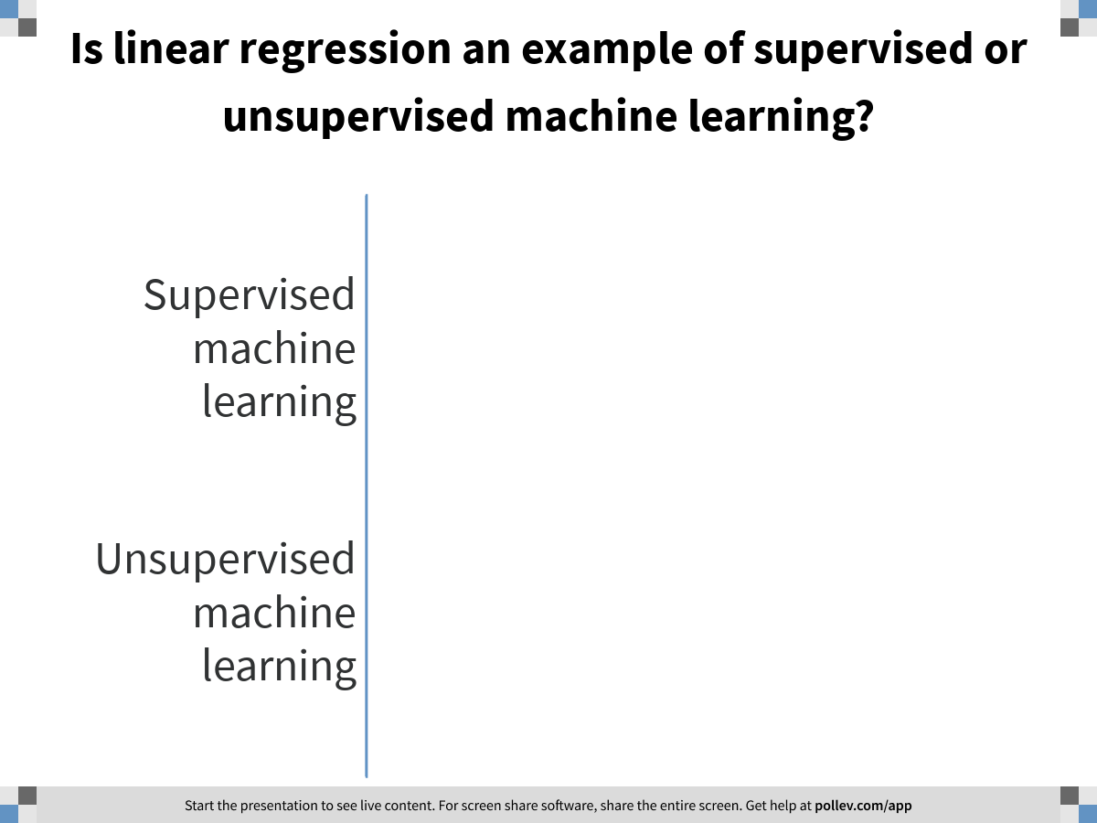
Notes:
Is linear regression an example of supervised or unsupervised machine learning?
https://www.polleverywhere.com/multiple_choice_polls/scpssb7iVyJiKiigtS0QS

Slide 32
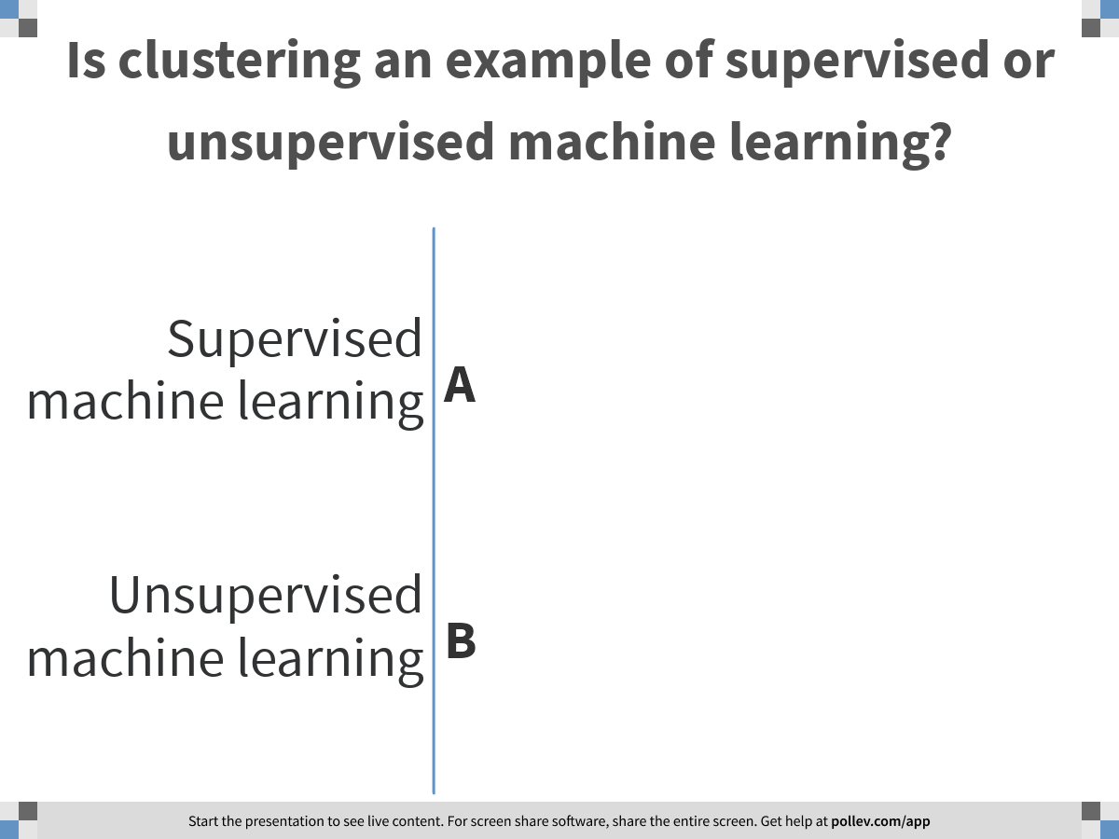
Notes:
Is clustering an example of supervised or unsupervised machine learning?
https://www.polleverywhere.com/multiple_choice_polls/aXbyOG4pwYRgnfVxxrpuf

Slide 33
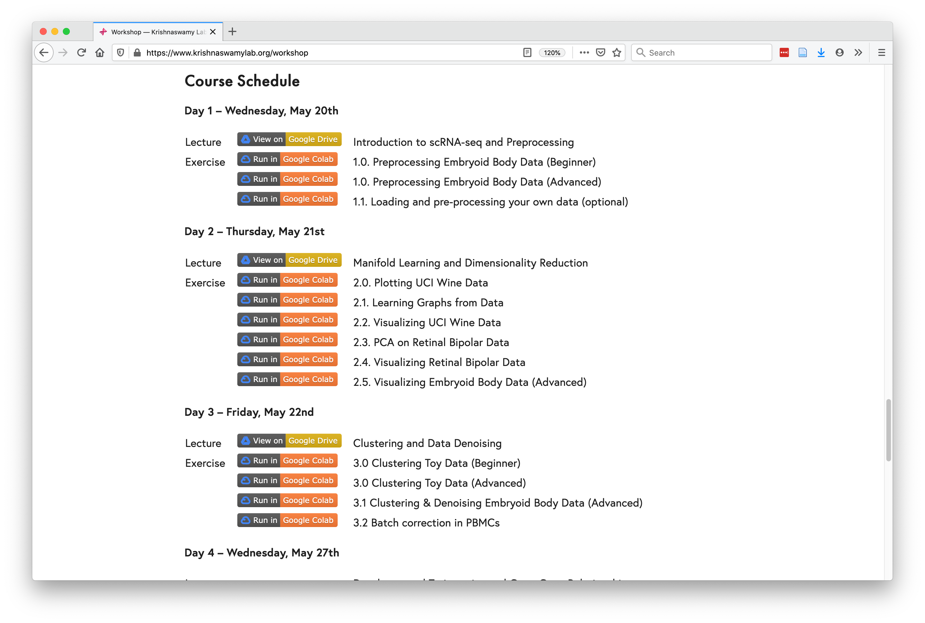
Course Schedule
https://www.krishnaswamylab.org/workshop

Slide 34

Why Python?

Slide 35
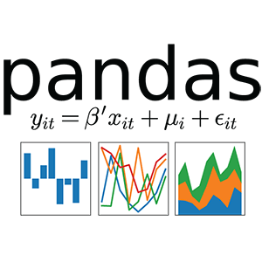

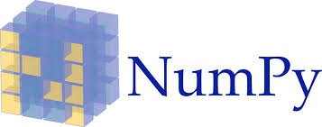




Why Python?
Tensorflow
Pytorch

Slide 36
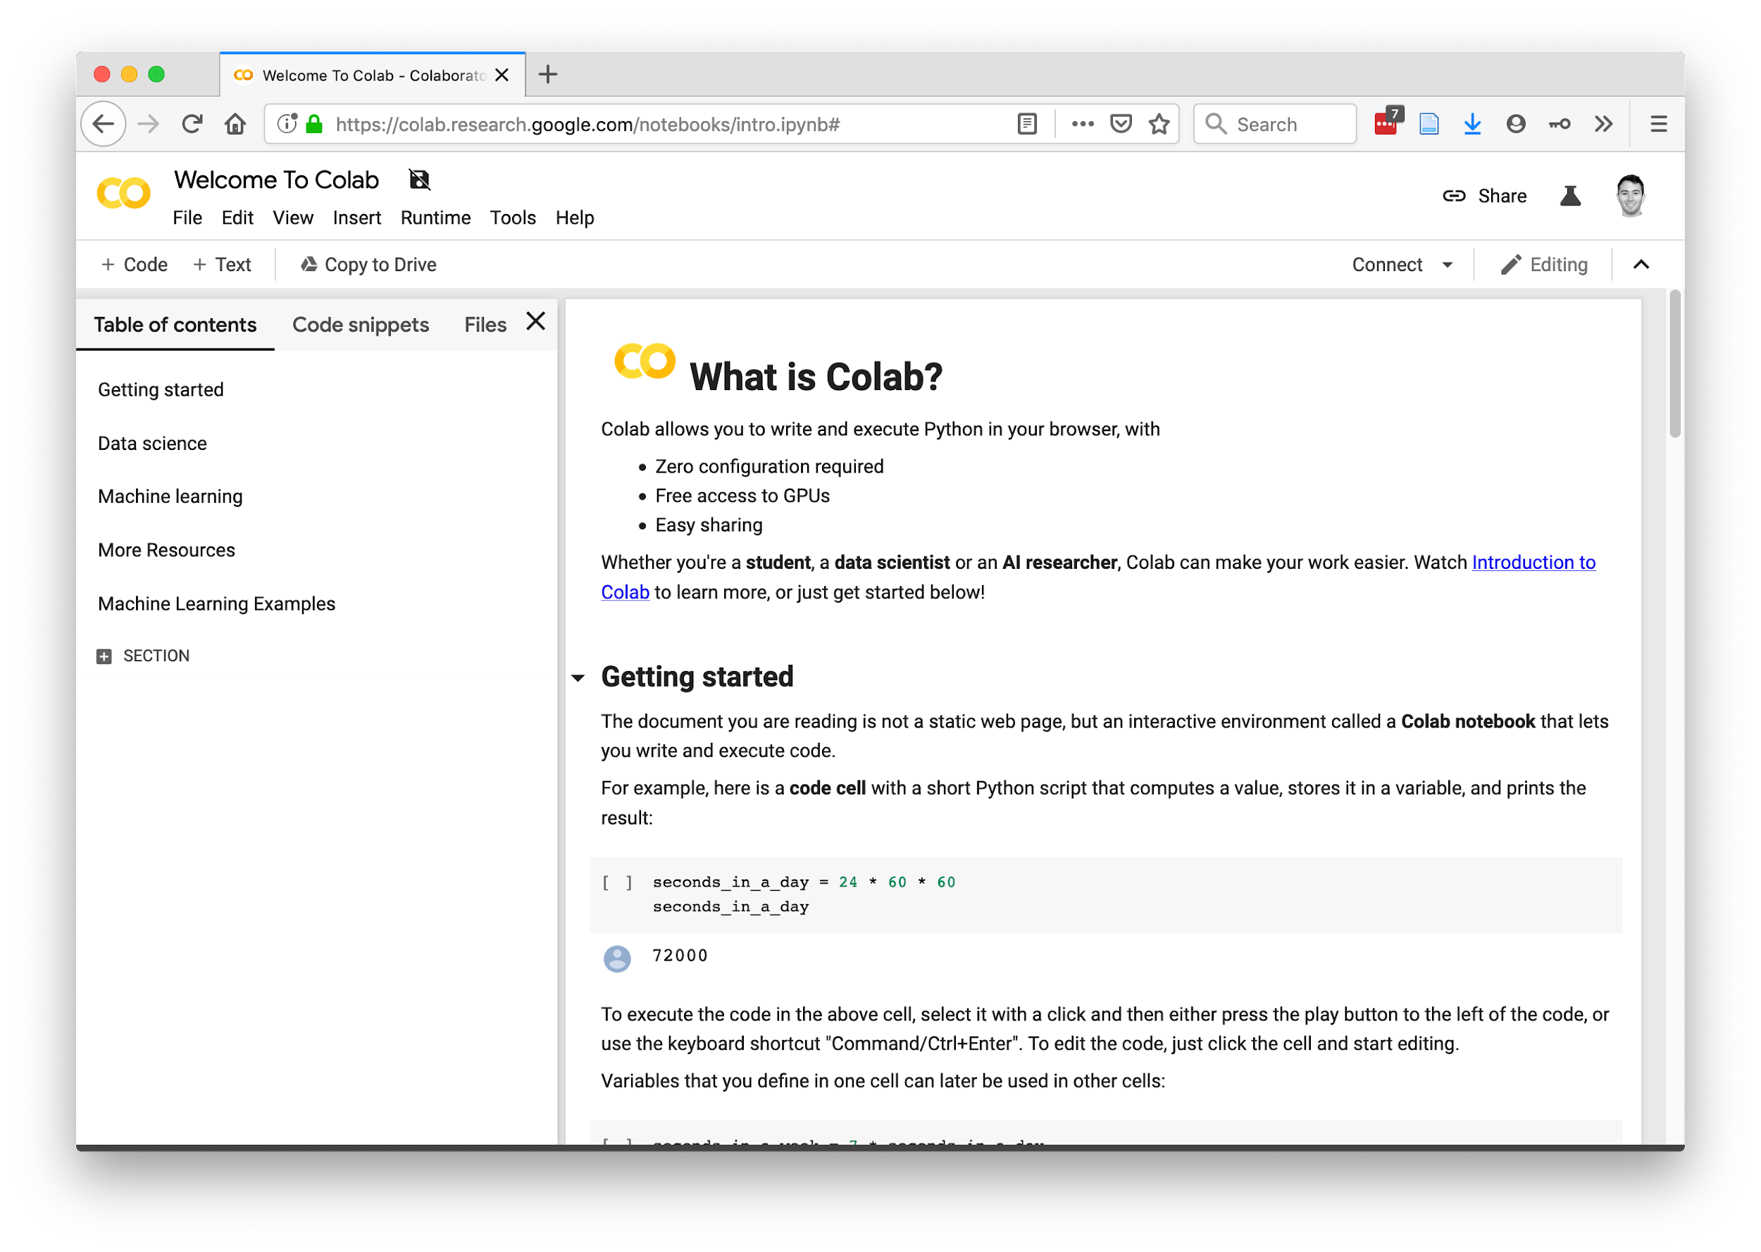
https://research.google.com/colaboratory/faq.html

Slide 37

Team programming
Noun project

Slide 38


vs.
Noun project

Slide 39


Slide 40
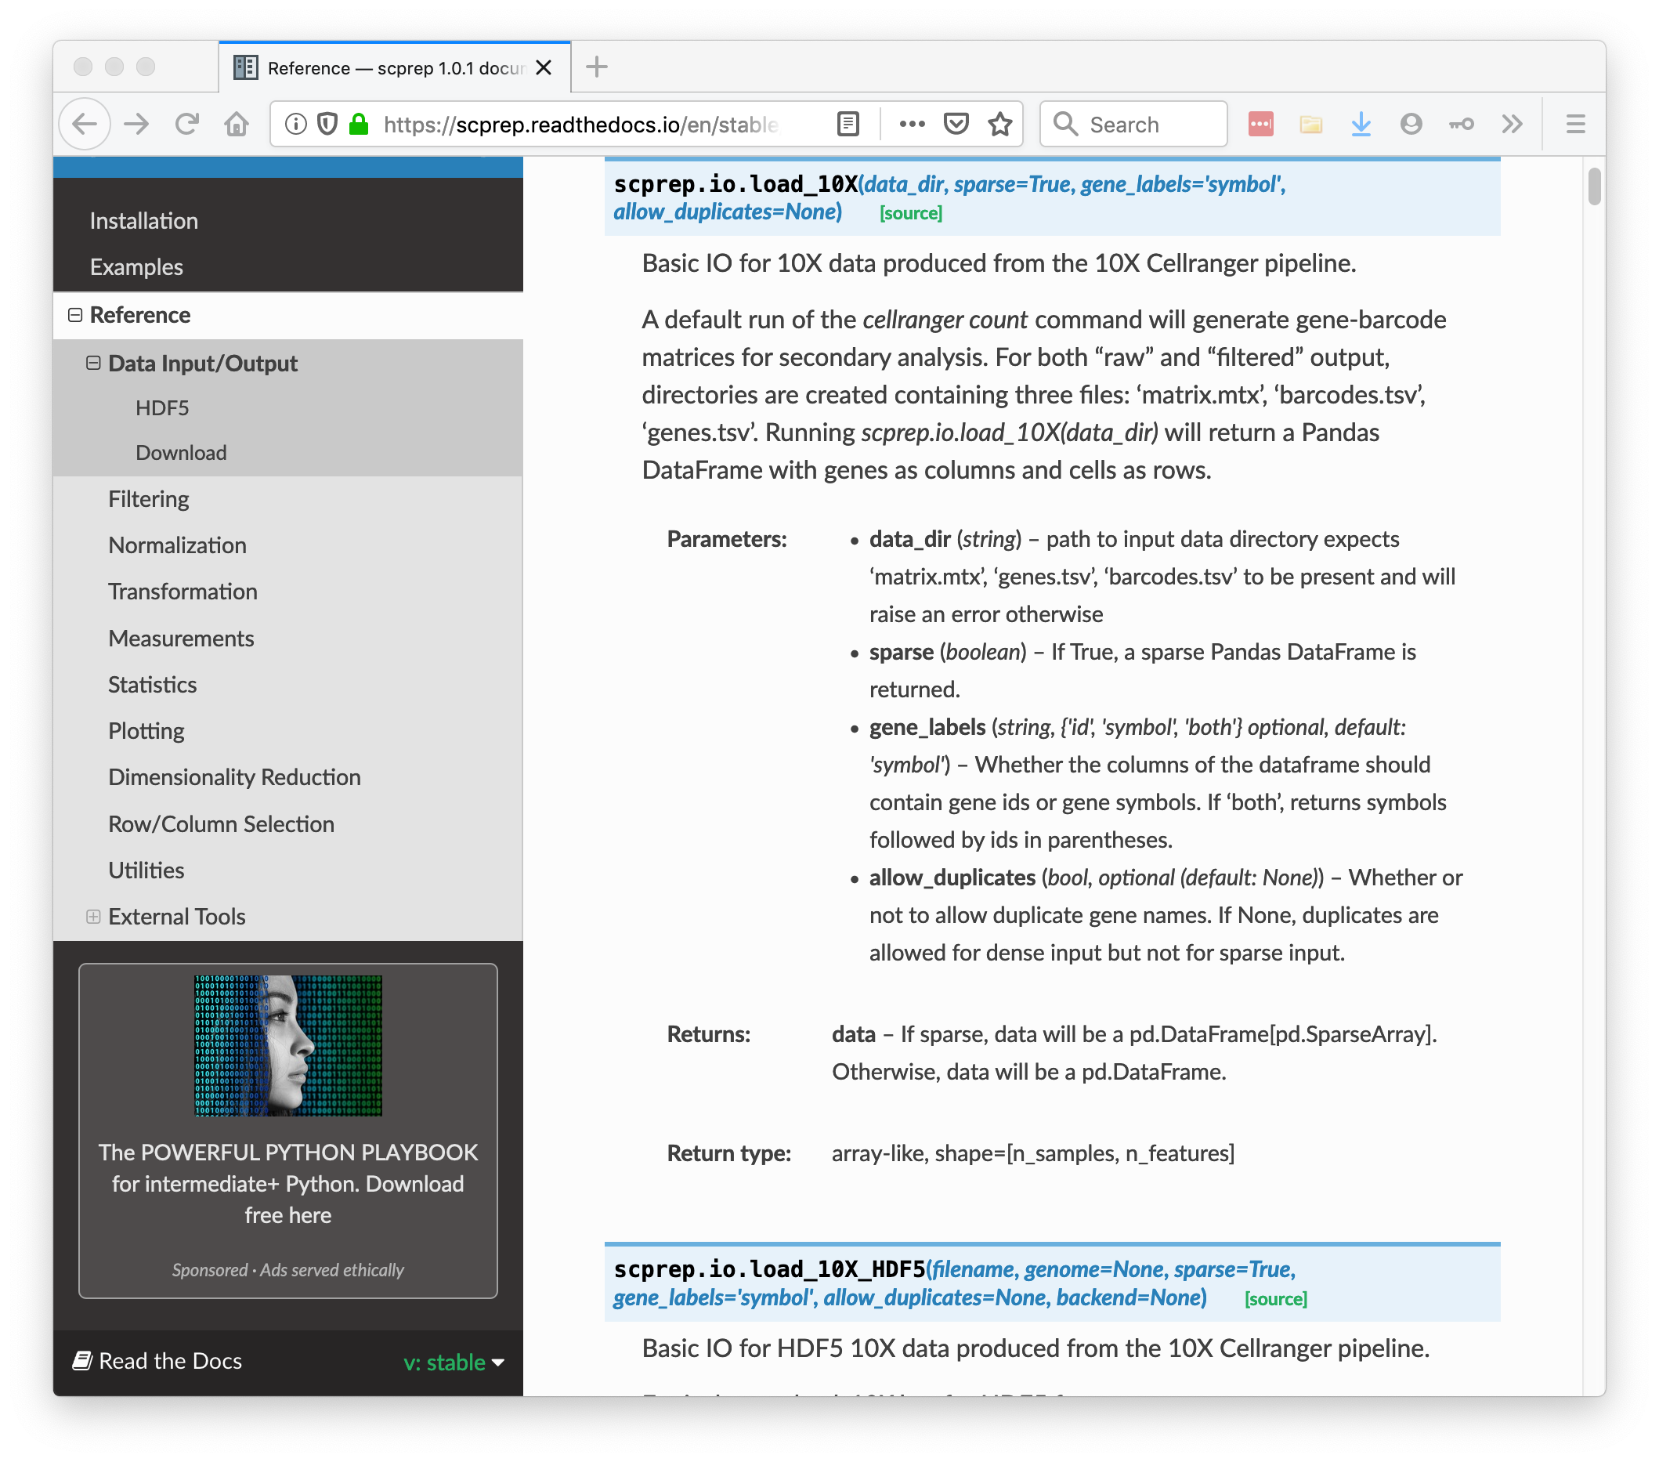

Slide 41

Bring-your-own-data workshop
#2020-workshop-byod-help
https://krishnaswamylab.org/get-help
Noun project

Slide 42
Challenges and Opportunities in Single Cell Data
Notes:
TA introduction
Talk about not teaching code (not a programming workshop)

Slide 43
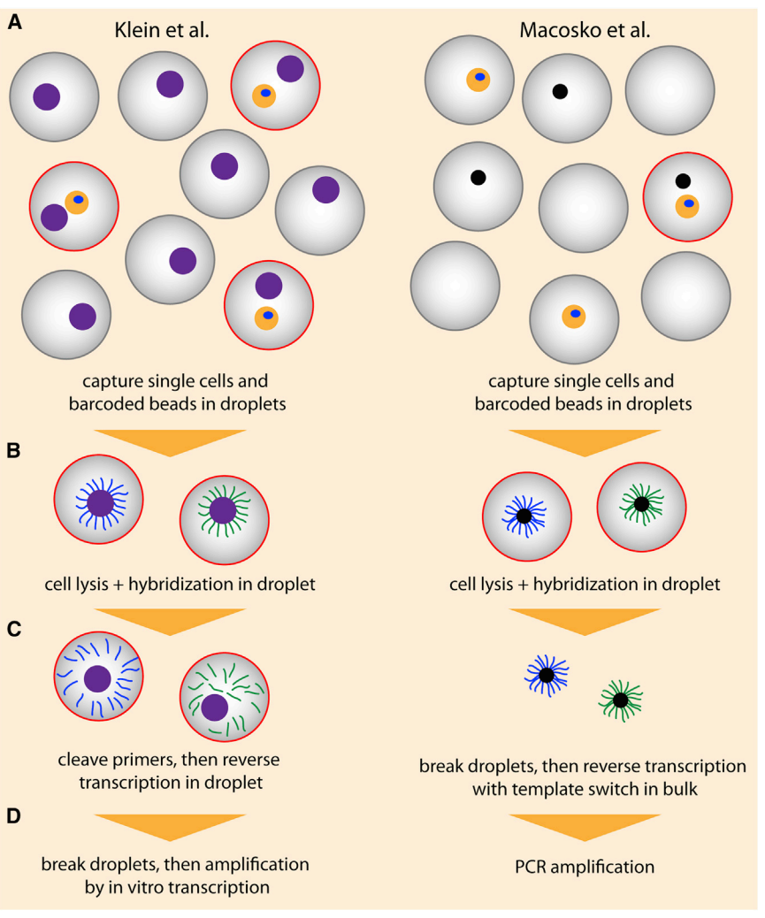
Droplet-based Technologies

Slide 44
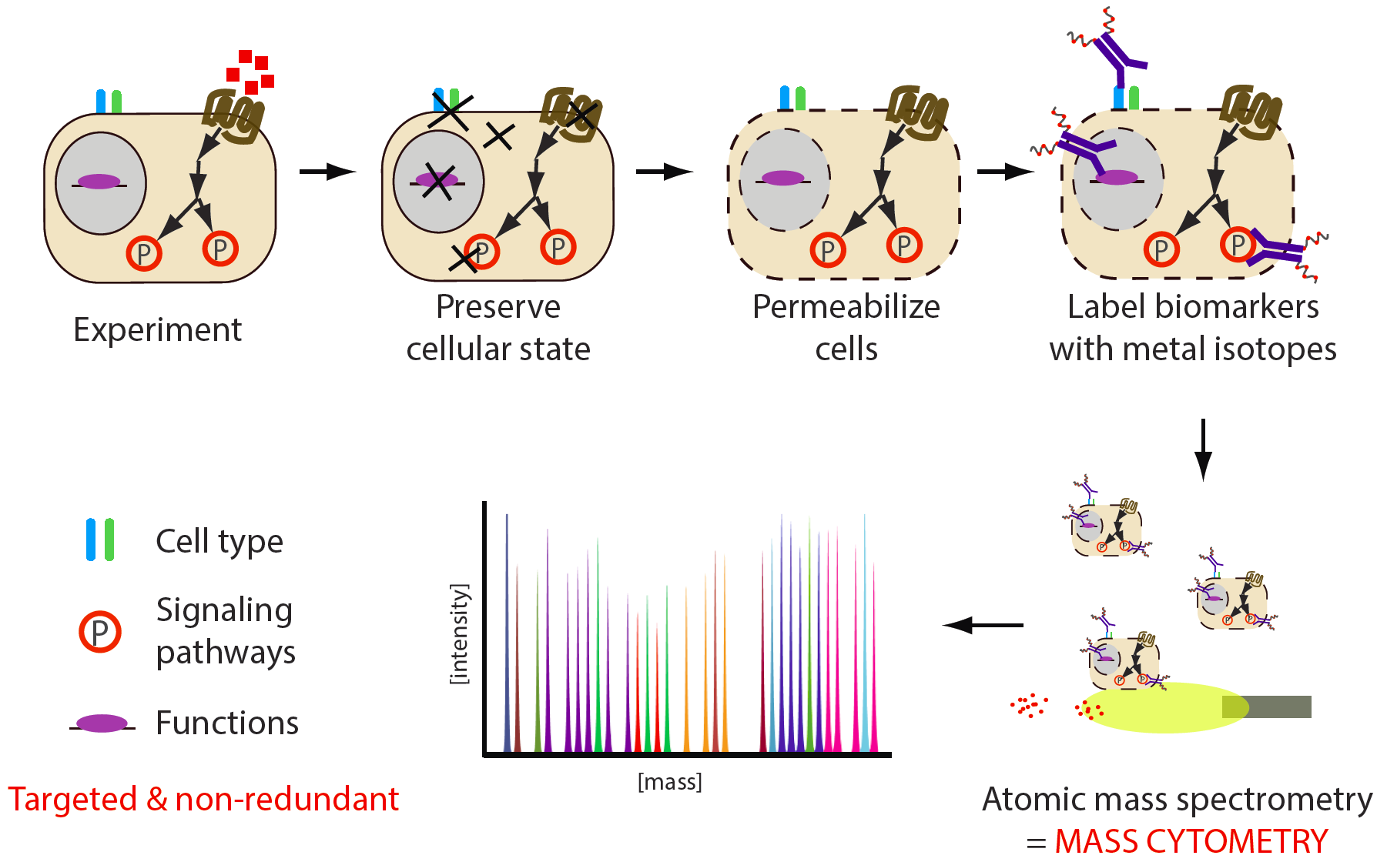
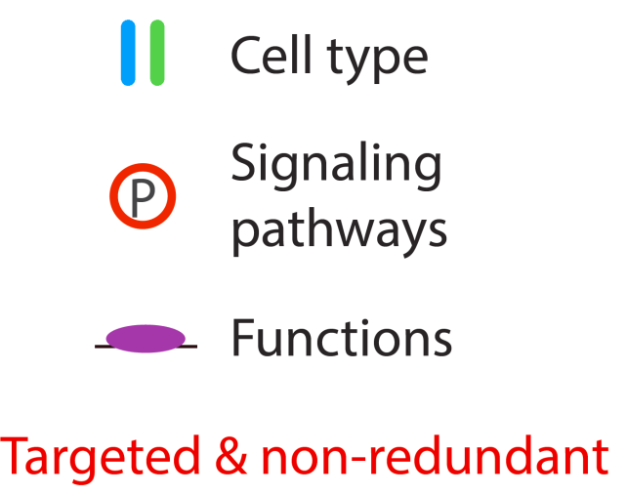
Single-Cell Proteomics: Mass Cytometry

Slide 45
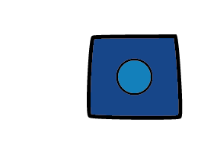
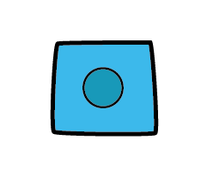
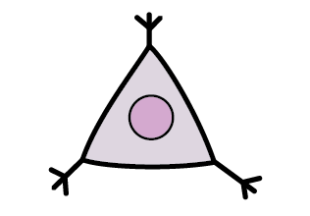
Single Cell Data
Each cell is a vector of measurements
e.g. Cell A = [40 0 20 18 5 0 …]
The whole data is a matrix with many observations (cells) and features (proteins, genes)
Features
(e.g. genes)
 | X | Y | Z
A | 10 | 20 | 70
B | 20 | 40 | 140
C | 20 | 0 | 80
Observations
(e.g. cells)

Slide 46
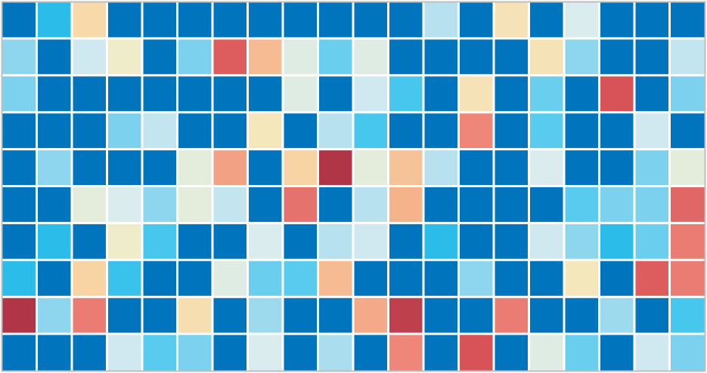
Single Cell Data
Samples
(1-10)
Cells
(1K – 10M)
Genes / Proteins
(10-10K)

Slide 47

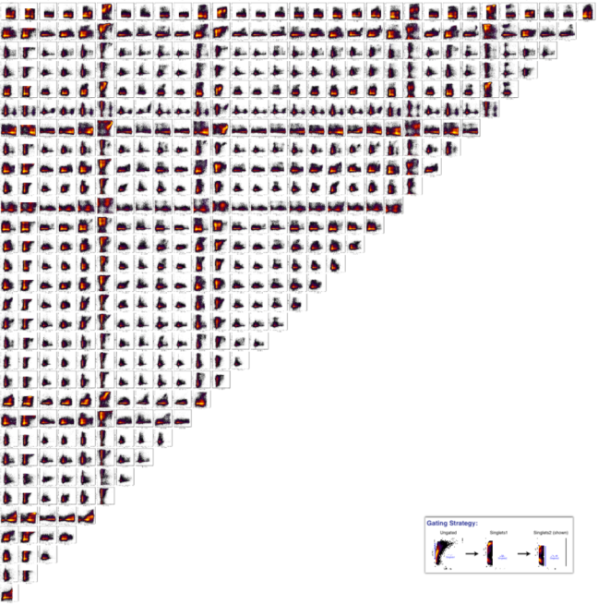

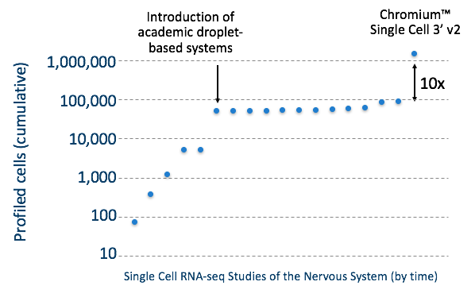

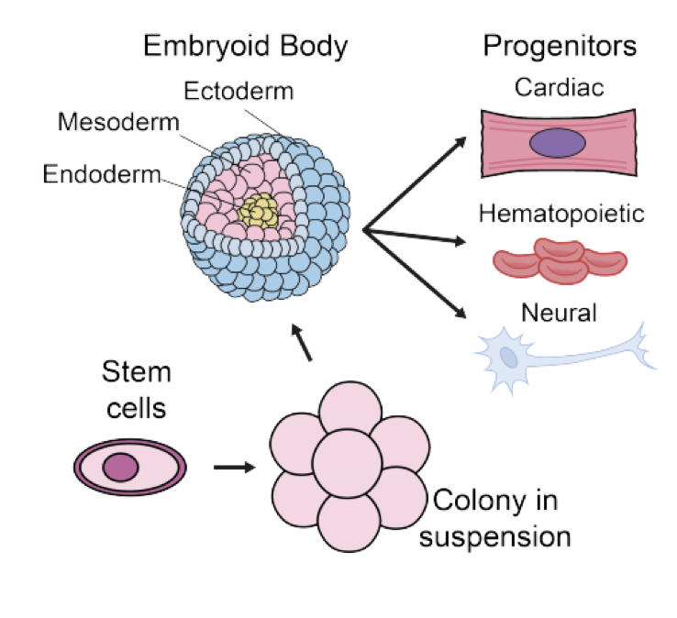
High Dimensional
High Throughput
Heterogeneous
Notes:
Features of this data is that its high dimensional ---gives us a view of the whole system, high throughput – measurements for thousands even hundreds of thousands of cells in each condition. And single cell resolution.

Slide 48








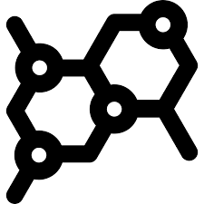
Many dimensions = many measurements
Diagnoses
labs
drug response
assays
ECG
Gene 1
Gene 2
Gene 3
Proteins

Slide 49
High Throughput = Many observations

Slide 50
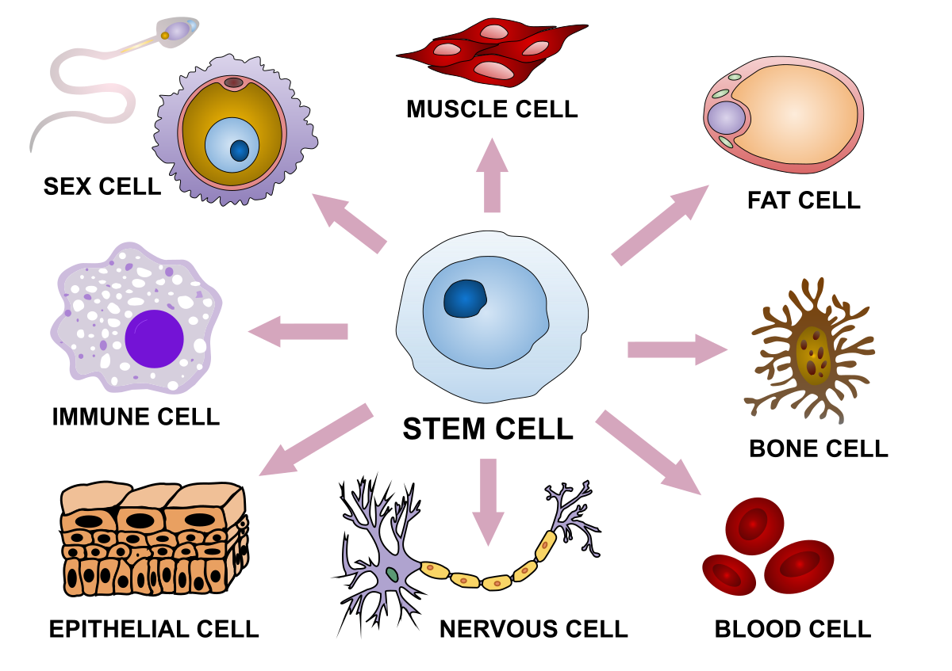

Heterogeneous Observations

Slide 51
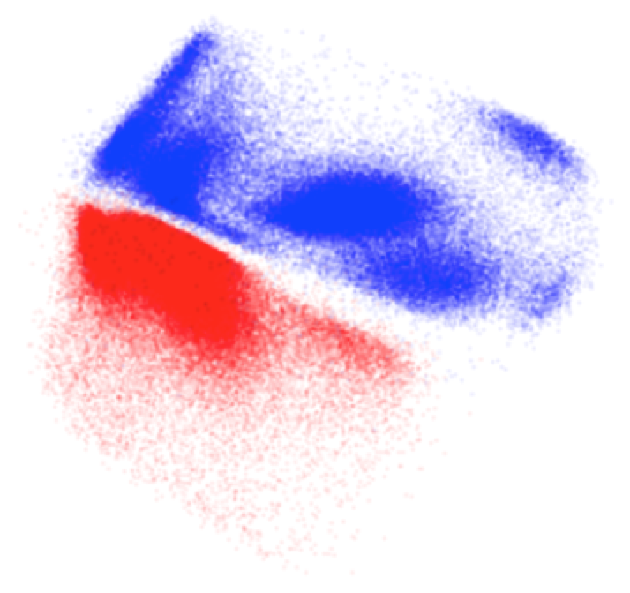
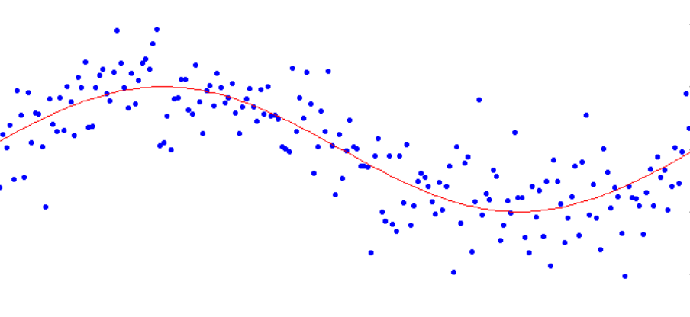
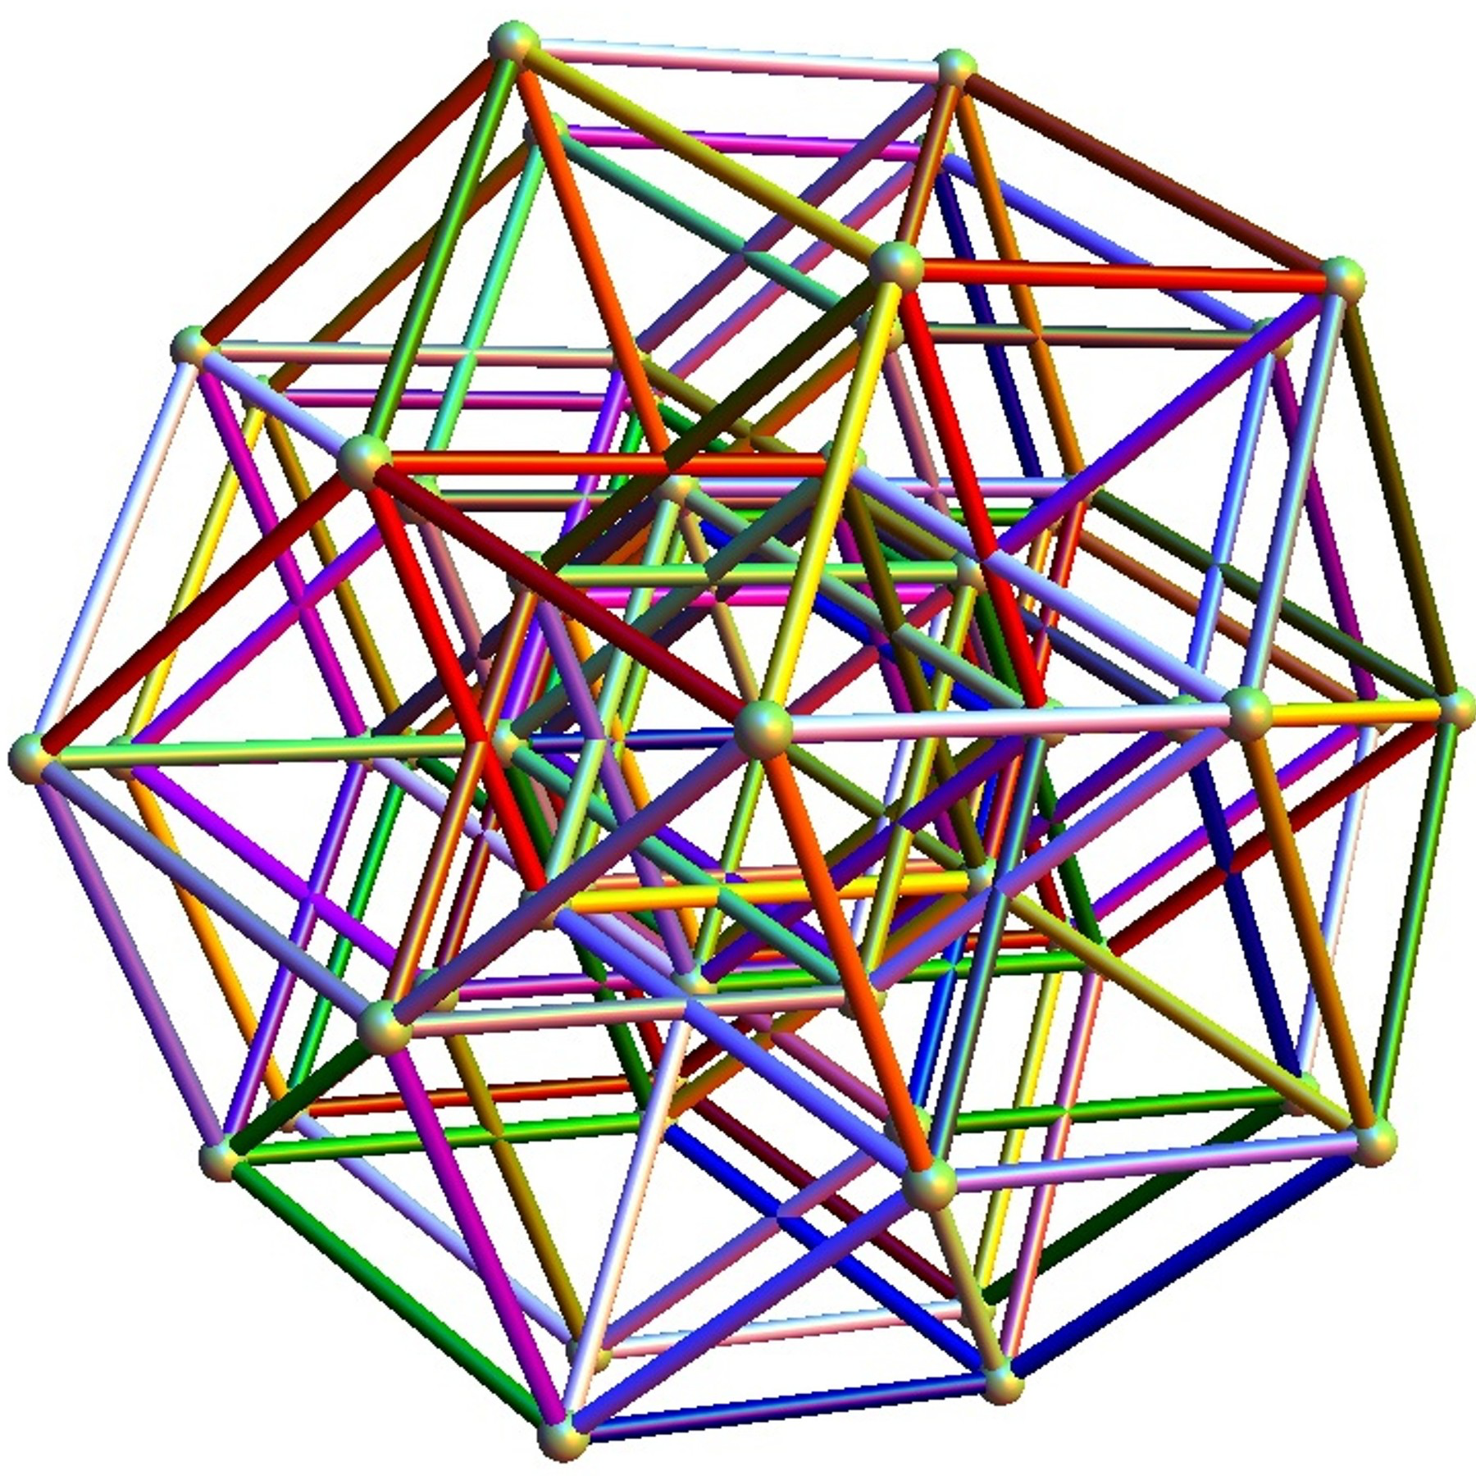

Challenges
Noise
Batch Effects
Dimensionality
Scale
Notes:
Features of this data is that its high dimensional ---gives us a view of the whole system, high throughput – measurements for thousands even hundreds of thousands of cells in each condition. And single cell resolution.

Slide 52
Noise

Slide 53
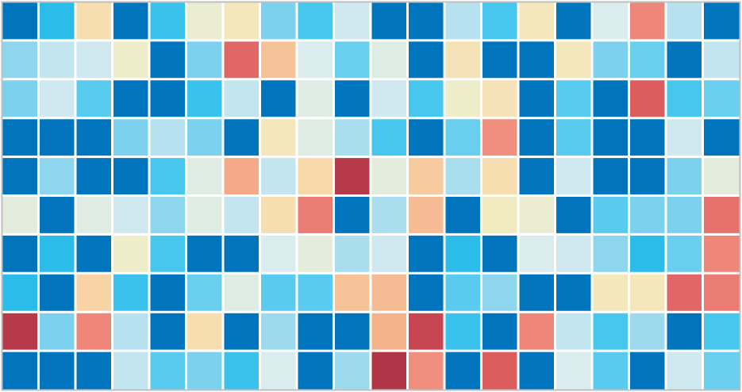
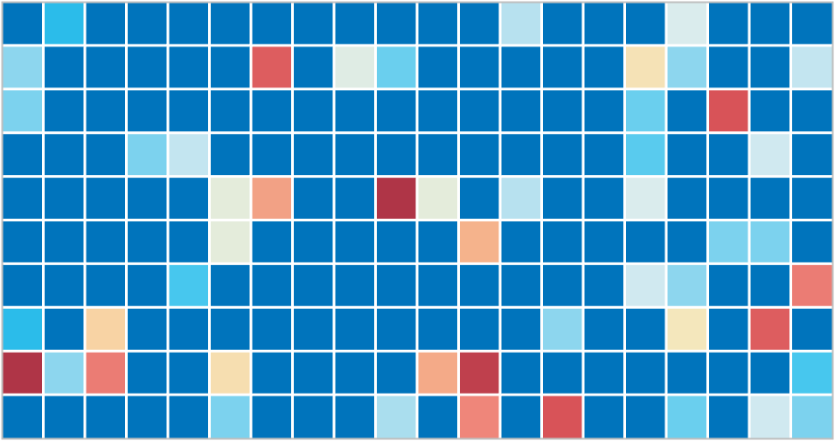
Dropout
Notes:
ideally: measure the expression of every gene in every
Samples only a small part of the transcriptome per cell
-- Tens of millions of individual measurements

Slide 54

Dropout vs Missing Data

Slide 55

Denoising Data

Slide 56
Batch Effects
Systematic differences between samples due to machine calibration, ambient environmental effects
Variation that is uninteresting to examine and confounds biological variation
Renders samples uncomparable

Slide 57


Slide 58
High Dimensionality
Difficult to understand the overall shape of the data
Number of subgroups, separations, progression

Slide 59


Latent structure in high dimensional data
Low-dimensional
manifold
Ambient Space

Slide 60





Gene-gene Relationships
Gene 2
Gene 3
Gene 1
Gene 2
Relationship between features?

Slide 61




Non-linear Relationships
pCD3z
pSLP76

Slide 62


Mutual Information

Slide 63



Embedding reveals structure
Dimension 2
Dimension 1
Use high dimensional features and high throughput to understand shape of data
Excellent
Responders
Fair
Responders
Poor
responders
Cluster structure

Slide 64

Retinal Bipolar Cells
Notes:
This is what we would want to see.
Cell types are well separated
We can see additional structure that is missed by the manual gating

Slide 65
Progression continuum
Dimension 2
Dimension 1
Use high dimensional features and high throughput to understand shape of data
Pseudotime
Early
Late

Slide 66

Progressions

Slide 67

Manifold Learning

Slide 68


Understanding the shape of data
Notes:
Global distance is not reliable, but local Euclidean steps are
We can use local Euclidean steps to “diffuse” through the manifold
Diffusion is equivalent to a random walk

Slide 69





Analysis Tasks

Slide 70
Preprocessing single-cell data
Notes:
TA introduction
Talk about not teaching code (not a programming workshop)

Slide 71

https://doi.org/10.15252/msb.20188746

Slide 72
Standard Single-Cell RNA-seq Workflow
Sequencing and read mapping
Quality control and filtering
Normalization
Data Correction
Add animation

Slide 73
Standard Single-Cell RNA-seq Workflow
Sequencing and read mapping
Quality control and filtering
Normalization
Data Correction
Dimensionality reduction and visualization
Add animation

Slide 74
Standard Single-Cell RNA-seq Workflow
Sequencing and read mapping
Quality control and filtering
Normalization
Data Correction
Dimensionality reduction and visualization
Downstream analysis
Clustering
Trajectory inference
Add animation

Slide 75
Standard Single-Cell RNA-seq Workflow
Sequencing and read mapping
Quality control and filtering
Normalization
Data Correction
Dimensionality reduction and visualization
Downstream analysis
Clustering
Trajectory inference
Differential expression
Add animation

Slide 76
Standard Single-Cell RNA-seq Workflow
Sequencing and read mapping
Quality control and filtering
Normalization
Data Correction
Dimensionality reduction and visualization
Downstream analysis
Clustering
Trajectory inference
Differential expression
Comparison of multiple conditions

Slide 77

Step 1 - Sequencing & read mapping
Building Counts Matrix → QC & Filtering → Normalization → Visualization → Analysis

Slide 78



Step 2 – Quality control and filtering
Dying cells
Multiplets
Empty Droplets
E.g.
low count depth
few detected genes
high fraction of mitochondrial counts
Building Counts Matrix → QC & Filtering → Normalization → Visualization → Analysis
Bad cells can be:
Dying cells,
Cells whose membranes are broken
Doublets
cytoplasmic mRNA has leaked out through a broken membrane
Unexpectedly high counts and a large number of detected genes means…?

Slide 79

Notes:
What could we look at to discriminate between dying cells, multiplets, or empty droplets and healthy single cells?
https://www.polleverywhere.com/discourses/UcO5ucV3uD4x4jbDv1PGc

Slide 80

Step 2 – Quality control and filtering
Building Counts Matrix → QC & Filtering → Normalization → Visualization → Analysis
Notes:
(A) Histograms of count depth per cell. The smaller histogram is zoomed‐in on count depths below 4,000. A threshold is applied here at 1,500 based on the peak detected at around 1,200 counts. (B) Histogram of the number of genes detected per cell. A small noise peak is visible at approx. 400 genes. These cells are filtered out using the depicted threshold (red line) at 700 genes. (C) Count depth distribution from high to low count depths. This visualization is related to the log–log plot shown in Cell Ranger outputs that is used to filter out empty droplets. It shows an “elbow” where count depths start to decrease rapidly around 1,500 counts. (D) Number of genes versus the count depth coloured by the fraction of mitochondrial reads. Mitochondrial read fractions are only high in particularly low count cells with few detected genes. These cells are filtered out by our count and gene number thresholds. Jointly visualizing the count and gene thresholds shows the joint filtering effect, indicating that a lower gene threshold may have sufficed. [Correction added on 5 July 2019, after first online publication: the x‐axis label in panel B was corrected from “Count depth” to “Number of genes”.]

Slide 81

Step 2 – Quality control and filtering
Building Counts Matrix → QC & Filtering → Normalization → Visualization → Analysis
Notes:
(A) Histograms of count depth per cell. The smaller histogram is zoomed‐in on count depths below 4,000. A threshold is applied here at 1,500 based on the peak detected at around 1,200 counts. (B) Histogram of the number of genes detected per cell. A small noise peak is visible at approx. 400 genes. These cells are filtered out using the depicted threshold (red line) at 700 genes. (C) Count depth distribution from high to low count depths. This visualization is related to the log–log plot shown in Cell Ranger outputs that is used to filter out empty droplets. It shows an “elbow” where count depths start to decrease rapidly around 1,500 counts. (D) Number of genes versus the count depth coloured by the fraction of mitochondrial reads. Mitochondrial read fractions are only high in particularly low count cells with few detected genes. These cells are filtered out by our count and gene number thresholds. Jointly visualizing the count and gene thresholds shows the joint filtering effect, indicating that a lower gene threshold may have sufficed. [Correction added on 5 July 2019, after first online publication: the x‐axis label in panel B was corrected from “Count depth” to “Number of genes”.]

Slide 82

Step 2 – Quality control and filtering
Building Counts Matrix → QC & Filtering → Normalization → Visualization → Analysis
Notes:
(A) Histograms of count depth per cell. The smaller histogram is zoomed‐in on count depths below 4,000. A threshold is applied here at 1,500 based on the peak detected at around 1,200 counts. (B) Histogram of the number of genes detected per cell. A small noise peak is visible at approx. 400 genes. These cells are filtered out using the depicted threshold (red line) at 700 genes. (C) Count depth distribution from high to low count depths. This visualization is related to the log–log plot shown in Cell Ranger outputs that is used to filter out empty droplets. It shows an “elbow” where count depths start to decrease rapidly around 1,500 counts. (D) Number of genes versus the count depth coloured by the fraction of mitochondrial reads. Mitochondrial read fractions are only high in particularly low count cells with few detected genes. These cells are filtered out by our count and gene number thresholds. Jointly visualizing the count and gene thresholds shows the joint filtering effect, indicating that a lower gene threshold may have sufficed. [Correction added on 5 July 2019, after first online publication: the x‐axis label in panel B was corrected from “Count depth” to “Number of genes”.]

Slide 83

Step 2 – Quality control and filtering
Building Counts Matrix → QC & Filtering → Normalization → Visualization → Analysis
Notes:
(A) Histograms of count depth per cell. The smaller histogram is zoomed‐in on count depths below 4,000. A threshold is applied here at 1,500 based on the peak detected at around 1,200 counts. (B) Histogram of the number of genes detected per cell. A small noise peak is visible at approx. 400 genes. These cells are filtered out using the depicted threshold (red line) at 700 genes. (C) Count depth distribution from high to low count depths. This visualization is related to the log–log plot shown in Cell Ranger outputs that is used to filter out empty droplets. It shows an “elbow” where count depths start to decrease rapidly around 1,500 counts. (D) Number of genes versus the count depth coloured by the fraction of mitochondrial reads. Mitochondrial read fractions are only high in particularly low count cells with few detected genes. These cells are filtered out by our count and gene number thresholds. Jointly visualizing the count and gene thresholds shows the joint filtering effect, indicating that a lower gene threshold may have sufficed. [Correction added on 5 July 2019, after first online publication: the x‐axis label in panel B was corrected from “Count depth” to “Number of genes”.]

Slide 84
Step 3 - Normalization
10% Capture Efficiency
20% CE
20% CE
Library size normalization (what we use)
Divide each cell by the sum of all counts (row-sum)
Multiply by some scalar (e.g. 10,000)
assumes that all cells in the dataset initially contained an equal number of mRNA molecules and count depth differences arise only due to sampling
Scran
size factors are estimated based on a linear regression over genes after cells are pooled
limits variability to fewer than 50% of genes being differentially expressed between cells
Many claims of superior performance by Leuken and Theis
Non-linear methods
Negative binomial regression (next week!)
Gene | Cell A
X | 10
Y | 20
Z | 70
Gene | Cell B
X | 20
Y | 40
Z | 140
Gene | Cell C
X | 20
Y | 0
Z | 80
If we only have gene expression, how can we determine which cells are similar?
Add animation
Building Counts Matrix → QC & Filtering → Normalization → Visualization → Analysis

Slide 85
Step 3 - Normalization
10% Capture Efficiency
20% CE
20% CE
Library size normalization (what we use)
Divide each cell by the sum of all counts (row-sum)
Multiply by some scalar (e.g. 10,000)
assumes that all cells in the dataset initially contained an equal number of mRNA molecules and count depth differences arise only due to sampling
Scran
size factors are estimated based on a linear regression over genes after cells are pooled
limits variability to fewer than 50% of genes being differentially expressed between cells
Many claims of superior performance by Leuken and Theis
Non-linear methods
Negative binomial regression (next week!)
Gene | Cell A
X | 10
Y | 20
Z | 70
Gene | Cell B
X | 20
Y | 40
Z | 140
Gene | Cell C
X | 20
Y | 0
Z | 80
Add animation
Building Counts Matrix → QC & Filtering → Normalization → Visualization → Analysis

Slide 86
Step 3 - Normalization
10% Capture Efficiency
20% CE
20% CE
Library size normalization (what we use)
Divide each cell by the sum of all counts (row-sum)
Multiply by some scalar (e.g. 10,000)
assumes that all cells in the dataset initially contained an equal number of mRNA molecules and count depth differences arise only due to sampling
Scran
size factors are estimated based on a linear regression over genes after cells are pooled
limits variability to fewer than 50% of genes being differentially expressed between cells
Many claims of superior performance by Leuken and Theis
Non-linear methods
Negative binomial regression (next week!)
Gene | Cell A
X | 10
Y | 20
Z | 70
Gene | Cell B
X | 20
Y | 40
Z | 140
Gene | Cell C
X | 20
Y | 0
Z | 80
Add animation
Building Counts Matrix → QC & Filtering → Normalization → Visualization → Analysis

Slide 87
Step 3 - Normalization
10% Capture Efficiency
20% CE
20% CE
Library size normalization (what we use)
Divide each cell by the sum of all counts (row-sum)
Multiply by some scalar (e.g. 10,000)
assumes that all cells in the dataset initially contained an equal number of mRNA molecules and count depth differences arise only due to sampling
Scran
size factors are estimated based on a linear regression over genes after cells are pooled
limits variability to fewer than 50% of genes being differentially expressed between cells
Many claims of superior performance by Leuken and Theis
Non-linear methods
Negative binomial regression (next week!)
Gene | Cell A
X | 10
Y | 20
Z | 70
Gene | Cell B
X | 20
Y | 40
Z | 140
Gene | Cell C
X | 20
Y | 0
Z | 80
Add animation
Building Counts Matrix → QC & Filtering → Normalization → Visualization → Analysis

Slide 88
Step 3 - Normalization
Raw counts
 | X | Y | Z
A | 10 | 20 | 70
B | 20 | 40 | 140
C | 20 | 0 | 80
Library size normalization (what we use)
Divide each cell by the sum of all counts (row-sum)
Multiply by some scalar (e.g. 10,000)
assumes that all cells in the dataset initially contained an equal number of mRNA molecules and count depth differences arise only due to sampling
Scran
size factors are estimated based on a linear regression over genes after cells are pooled
limits variability to fewer than 50% of genes being differentially expressed between cells
Many claims of superior performance by Leuken and Theis
Non-linear methods
Negative binomial regression (next week!)

Slide 89
Step 3 - Normalization
Raw counts
 | X | Y | Z
A | 10 | 20 | 70
B | 20 | 40 | 140
C | 20 | 0 | 80
Library size normalization (what we use)
Divide each cell by the sum of all counts (row-sum)
Multiply by some scalar (e.g. 10,000)
assumes that all cells in the dataset initially contained an equal number of mRNA molecules and count depth differences arise only due to sampling
Scran
size factors are estimated based on a linear regression over genes after cells are pooled
limits variability to fewer than 50% of genes being differentially expressed between cells
Many claims of superior performance by Leuken and Theis
Non-linear methods
Negative binomial regression (next week!)
dist(A,B) = $\sqrt{{\left(x_{A}−x_{B}\right)}^{2}+{\left(y_{a}−y_{b}\right)}^{2}+{\left(z_{a}−z_{b}\right)}^{2}}$

Slide 90
Step 3 - Normalization
Raw counts
 | X | Y | Z
A | 10 | 20 | 70
B | 20 | 40 | 140
C | 20 | 0 | 80
Pairwise distances
dist(A,B) = 71.4
Library size normalization (what we use)
Divide each cell by the sum of all counts (row-sum)
Multiply by some scalar (e.g. 10,000)
assumes that all cells in the dataset initially contained an equal number of mRNA molecules and count depth differences arise only due to sampling
Scran
size factors are estimated based on a linear regression over genes after cells are pooled
limits variability to fewer than 50% of genes being differentially expressed between cells
Many claims of superior performance by Leuken and Theis
Non-linear methods
Negative binomial regression (next week!)
dist(A,B) = $\sqrt{{\left(x_{A}−x_{B}\right)}^{2}+{\left(y_{a}−y_{b}\right)}^{2}+{\left(z_{a}−z_{b}\right)}^{2}}$

Slide 91
Step 3 - Normalization
Raw counts
 | X | Y | Z
A | 10 | 20 | 70
B | 20 | 40 | 140
C | 20 | 0 | 80
Pairwise distances
dist(A,B) = 71.4
dist(A,C) = 24.5
dist(B,C) = 67.1
Library size normalization (what we use)
Divide each cell by the sum of all counts (row-sum)
Multiply by some scalar (e.g. 10,000)
assumes that all cells in the dataset initially contained an equal number of mRNA molecules and count depth differences arise only due to sampling
Scran
size factors are estimated based on a linear regression over genes after cells are pooled
limits variability to fewer than 50% of genes being differentially expressed between cells
Many claims of superior performance by Leuken and Theis
Non-linear methods
Negative binomial regression (next week!)
dist(A,B) = $\sqrt{{\left(x_{A}−x_{B}\right)}^{2}+{\left(y_{a}−y_{b}\right)}^{2}+{\left(z_{a}−z_{b}\right)}^{2}}$

Slide 92
Step 3 - Normalization
Raw counts
 | X | Y | Z
A | 10 | 20 | 70
B | 20 | 40 | 140
C | 20 | 0 | 80
Library
Size
Pairwise distances
100
200
100
dist(A,B) = 71.4
dist(A,C) = 24.5
dist(B,C) = 67.1
Library size normalization (what we use)
Divide each cell by the sum of all counts (row-sum)
Multiply by some scalar (e.g. 10,000)
assumes that all cells in the dataset initially contained an equal number of mRNA molecules and count depth differences arise only due to sampling
Scran
size factors are estimated based on a linear regression over genes after cells are pooled
limits variability to fewer than 50% of genes being differentially expressed between cells
Many claims of superior performance by Leuken and Theis
Non-linear methods
Negative binomial regression (next week!)
dist(A,B) = $\sqrt{{\left(x_{A}−x_{B}\right)}^{2}+{\left(y_{a}−y_{b}\right)}^{2}+{\left(z_{a}−z_{b}\right)}^{2}}$

Slide 93
Step 3 - Normalization
Normalized counts
 | X | Y | Z
A | 0.1 | 0.2 | 0.7
B | 0.1 | 0.2 | 0.7
C | 0.2 | 0 | 0.8
Library
Size
Pairwise distances
100
200
100
dist(A,B) = 71.4
dist(A,C) = 24.5
dist(B,C) = 67.1
Library size normalization (what we use)
Divide each cell by the sum of all counts (row-sum)
Multiply by some scalar (e.g. 10,000)
assumes that all cells in the dataset initially contained an equal number of mRNA molecules and count depth differences arise only due to sampling
Scran
size factors are estimated based on a linear regression over genes after cells are pooled
limits variability to fewer than 50% of genes being differentially expressed between cells
Many claims of superior performance by Leuken and Theis
Non-linear methods
Negative binomial regression (next week!)
dist(A,B) = $\sqrt{{\left(x_{A}−x_{B}\right)}^{2}+{\left(y_{a}−y_{b}\right)}^{2}+{\left(z_{a}−z_{b}\right)}^{2}}$

Slide 94
Step 3 - Normalization
Normalized counts
 | X | Y | Z
A | 0.1 | 0.2 | 0.7
B | 0.1 | 0.2 | 0.7
C | 0.2 | 0 | 0.8
Library
Size
Pairwise distances
100
200
100
dist(A,B) = 0
dist(A,C) = 0.25
dist(B,C) = 0.25
Library size normalization (what we use)
Divide each cell by the sum of all counts (row-sum)
Multiply by some scalar (e.g. 10,000)
assumes that all cells in the dataset initially contained an equal number of mRNA molecules and count depth differences arise only due to sampling
Scran
size factors are estimated based on a linear regression over genes after cells are pooled
limits variability to fewer than 50% of genes being differentially expressed between cells
Many claims of superior performance by Leuken and Theis
Non-linear methods
Negative binomial regression (next week!)
dist(A,B) = $\sqrt{{\left(x_{A}−x_{B}\right)}^{2}+{\left(y_{a}−y_{b}\right)}^{2}+{\left(z_{a}−z_{b}\right)}^{2}}$

Slide 95

More complex normalization approaches exist
https://doi.org/10.1186/s13059-016-0947-7

Slide 96
Step 3.5 – Transformation / Scaling
Normalized counts
 | X | Y | Z
A | 0.1 | 0.2 | 0.7
B | 0.1 | 0.2 | 0.7
C | 0.2 | 0 | 0.8
Library size normalization (what we use)
Divide each cell by the sum of all counts (row-sum)
Multiply by some scalar (e.g. 10,000)
assumes that all cells in the dataset initially contained an equal number of mRNA molecules and count depth differences arise only due to sampling
Scran
size factors are estimated based on a linear regression over genes after cells are pooled
limits variability to fewer than 50% of genes being differentially expressed between cells
Many claims of superior performance by Leuken and Theis
Non-linear methods
Negative binomial regression (next week!)
What if this is a housekeeping gene?
What if this is a transcription factor?
Building Counts Matrix → QC & Filtering → Normalization → Visualization → Analysis

Slide 97
Step 3.5 – Transformation / Scaling
sqrt(normalized counts)
 | X | Y | Z
A | 0.32 | 0.45 | 0.84
B | 0.32 | 0.45 | 0.89
C | 0.2 | 0 | 0.89
Library size normalization (what we use)
Divide each cell by the sum of all counts (row-sum)
Multiply by some scalar (e.g. 10,000)
assumes that all cells in the dataset initially contained an equal number of mRNA molecules and count depth differences arise only due to sampling
Scran
size factors are estimated based on a linear regression over genes after cells are pooled
limits variability to fewer than 50% of genes being differentially expressed between cells
Many claims of superior performance by Leuken and Theis
Non-linear methods
Negative binomial regression (next week!)
What if this is a housekeeping gene?
What if this is a transcription factor?
Building Counts Matrix → QC & Filtering → Normalization → Visualization → Analysis

Slide 98

Notes:
What kind of transformations, other than square-root, could we apply to single cell data?
https://www.polleverywhere.com/discourses/RSvObGwo3r8r5cjggv9zW

Slide 99

Step 5 – Dimensionality reduction and visualization
Selecting highly variable genes (HVGs):
Calculate log10 mean expression and variance
Fit a loess curve
Standardize variance to mean 0 std 1
Take the top 2000 HVGs
Building Counts Matrix → QC & Filtering → Normalization → Visualization → Analysis
https://satijalab.org/seurat/v3.1/pbmc3k_tutorial.html

Slide 100
Standard Single-Cell RNA-seq Workflow
Sequencing and read mapping
Quality control and filtering
Normalization
Data Correction
Dimensionality reduction and visualization
Downstream analysis
Clustering
Trajectory inference
Differential expression
Comparison of multiple conditions

Slide 101

Notes:
What questions do you have about today's material?
https://www.polleverywhere.com/discourses/OwyeOZgCO1pghr2PFpmJz

Slide 102




Exercise!
Load, preprocess, and visualize a scRNAseq dataset generated from a time course of embryoid bodies

